Slide 1


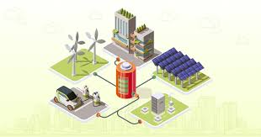
Title –
Design of IOT Architecture for
Battery Charging Management Technology
Presentation on
Major project
Presented by
Jagadeesh_(AP2312210002)
under the Esteemed guidance of
Dr. Sujith Kalluri Ph.D
Associate Professor
School of Engineering and Sciences (SEAS)
Department of Electronics and Communication Engineering
SRM University, Andhra Pradesh (SRM AP)

Slide 2

Outline
Abstract
Problem Statement and Research Gap
Types of Charging Technology
Literature survey
Proposed Methodology
Conclusion
Tools used
IOT Architecture for Battery charging management
PCC integration and Automation
Algorithms
Designed Proposed Simulation Model in MATAB Simulation
Integrated PCC –Fully Automated & Logically connected
Swapping Station and DC Fast Charging
Central Monitoring Station
Calculated Spread sheet

Slide 3

Abstract
Problem: Rapid EV adoption faces challenges like range anxiety, inconsistent charging, and limited infrastructure.
Solution: IoT-based architecture for efficient battery charging.
Features: Real-time monitoring, predictive analytics, mobile charging units, centralized cloud platform, and user-friendly mobile app.
Benefits: Enhanced user experience, optimized energy management, improved accessibility, and promotion of EVs and sustainable energy.
Significance: Addresses critical issues in EV charging, contributes to a cleaner future, and drives technological advancement.

Slide 4

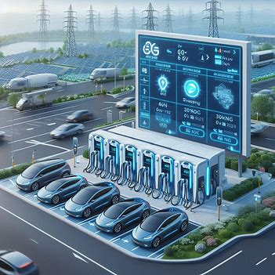
Problem Statement and Research Gap with IOT Tech
Lack of Pollution – need More Transportation – Need coal mines – More Generation cost
Why IOT needed
Real Time Data Monitoring
Pre estimation Power Demand
To Reuse Harmonic's Imbalance
Central Monitoring System
End User Integration
EV are Rapidly Increasing in the world Automotive Market
So, There is a Demand of Charging Infra

Slide 5
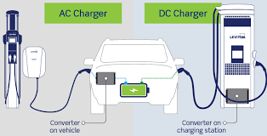
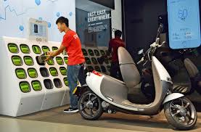
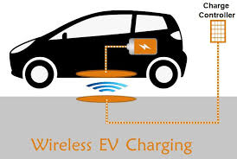
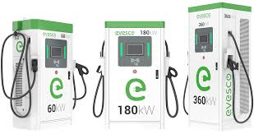
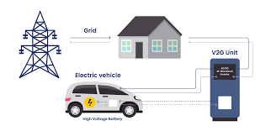
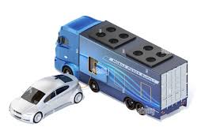
Types of Charging Technology
AC Charging
DC Charging
Battery Swapping
Wireless Charging
Vehicle-to-Grid (V2G) Technology
Fast Charging Technologies
Mobile charging

Slide 6
Literature survey
Growth of Electric Vehicles (EVs): The literature emphasizes the increasing adoption of EVs and the urgent need for more charging stations to alleviate range anxiety, with IoT technology playing a crucial role in enhancing station development and monitoring.
Power Quality Management: Research discusses the impact of EV charging on power quality, proposing active filters to mitigate harmonic distortion and improve overall power infrastructure.
Challenges in Residential Charging: High installation costs and limited charging ports are identified as barriers to home EV adoption. IoT solutions can enhance accessibility and user experience, with a holistic approach recommended for effective residential charging infrastructure.
Battery Swapping Integration: Studies explore the integration of battery swapping stations with traditional charging stations, focusing on optimal placement and operational strategies to improve efficiency and support urban mobility initiatives.
Energy Management Technologies: Various studies highlight the significance of energy management technologies in optimizing energy efficiency within renewable sectors, focusing on factors like energy information collection, economic analysis, and operational strategies for Energy Storage System (ESS) capacity planning.
Mobile Battery Swapping Services: A novel approach to battery swapping services is presented, detailing structural architecture for efficient operations, user communication via mobile applications, and analysis of power consumption and runtime for swapping units.
IoT-Enabled Continuous Monitoring: IoT technology facilitates continuous monitoring of EV charging processes, which helps prevent battery damage during charging. This capability ensures optimal charging conditions and enhances the overall lifespan and performance of EV batteries.

Slide 7
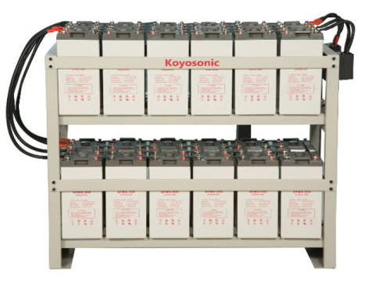
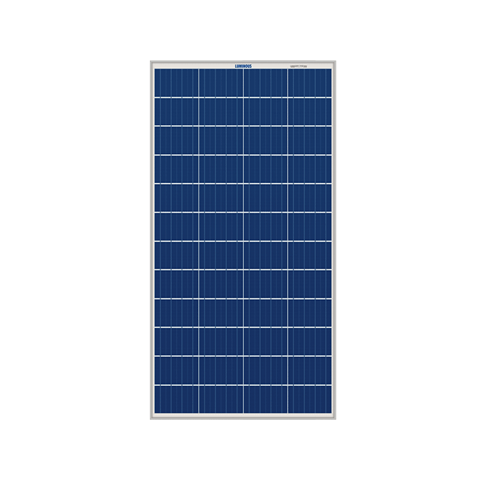
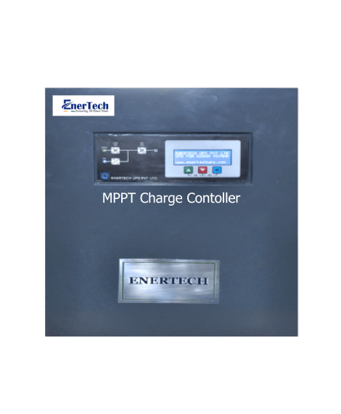





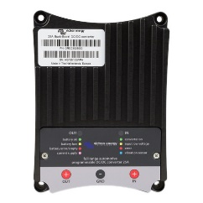

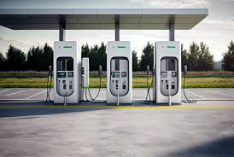


Proposed Methodology
Bi directional converter
Grid
MPPT
Central Control Monitoring
Solar
ESS
Buck – Boost converter
Cloud
Swapping
Fast Charging
User Interface

Slide 8

User Interface Application Layer
IOT Architecture for Battery charging management
Application Layer
Presentation Layer
Session Layer
Transport Layer
Network Layer
Data Link Layer
Physical Layer
Cloud Server Layer Data storage
Communication Layer IoT Gateway Layer Processing Layer
Microcontroller Layer BMS Layer Data Acquisition Layer Processing Unit Layer
Sensor Layer

Slide 9




Flow of Project
Collected Data
Storage
Central control Pannel
User Interface

Slide 10
Cloud Based Data Storage
Alerts
User data Visualization

Slide 11
End to End Flow
Start
Check for the power source
Solar
ESS
Grid
PCC – Point of Common Coupling
Solar – ON → ESS Charge → Grid OFF → Load ON
Solar – ON → ESS >80% → [Grid DC- AC] ON → Load ON
Solar – OFF → ESS ON → Grid OFF → Load ON
Solar – OFF → ESS <20% → [Grid AC- DC] ON → Load ON
Solar – OFF → ESS charge → [Grid AC- DC] ON → Load OFF
Battery Swapping Station
DC Fast Charging Station

Slide 12
PCC integration and Automation
Start
Grid Off
IF
Solar Available
IF
Solar Not Available
Grid Off
ESS ON
ESS
< 20%
Load On
ESS Charging > 80%
Load On
Power to Grid
Grid
Power
ON
Load On
No Load
ESS Charging
Upto Solar Available
Cycle Continuous

Slide 13
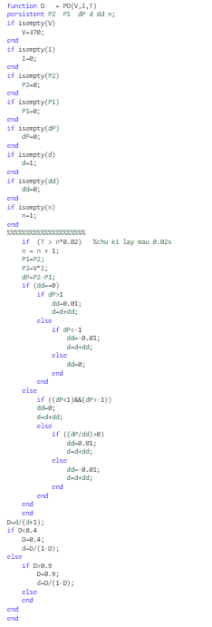
Algorithms
Solar MPPT
Initialize Variables Check if input parameters VV (voltage), II (current), and TT (time) are empty.
Set default values if any parameter is empty:V=370V=370
I=0I=0, P2=0P2=0, P1=0P1=0, dP=0dP=0, d=1d=1, dd=0dd=0, n=1n=1
Check Time ConditionIf T>n∗0.02T>n∗0.02:Increment nn by 1
Update previous power values:P1=P2P1=P2
P2=V∗IP2=V∗I (Calculate current power)
Calculate Power ChangeCalculate change in power:dP=P2−P1dP=P2−P1
Adjust Duty Cycle Based on Power ChangeIf dd==0dd==0:If dP>1dP>1:Set dd=0.01dd=0.01
Increment dd by dddd
Else if dP<−1dP<−1:Set dd=−0.01dd=−0.01
Increment dd by dddd
Else:Set dd=0dd=0
If Duty Cycle Adjustment is ActiveIf (dP<1)&&(dP>-1):Set dd=0
Increment d by dd
Else:If (dP/dd)>0:Set dd=0.01
Increment d by dd
Else:Set dd=-0.01
Increment d by dd
Calculate Duty Cycle DCalculate duty cycle:D=d/(d+1)
Limit Duty Cycle ValuesIf D<0.4:Set D=0.4
Update duty cycle:d=D/(1-D)
Else if D>0.9:Set D=0.9
Update duty cycle:d=D/(1-D)
End of Algorithm Return the final value of duty cycle D.

Slide 14
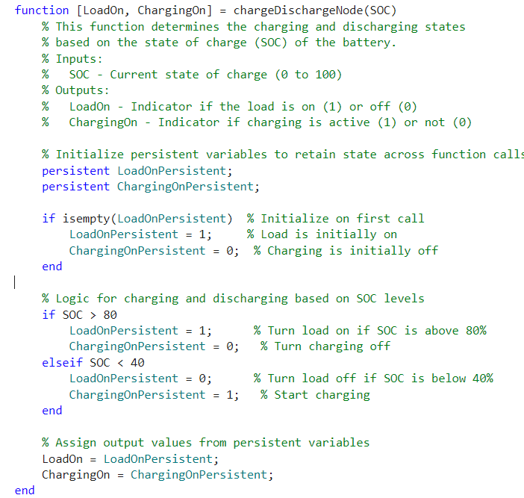
Algorithms
Battery Swapping Station -- Charging
Initialize Persistent Variables:
  Check if LoadOnPersistent and ChargingOnPersistent are empty.
  If empty, set:
    LoadOnPersistent = 1 (Load is initially ON)
    ChargingOnPersistent = 0 (Charging is initially OFF)
Check State of Charge (SOC):
  If SOC > 80:
    Set LoadOnPersistent = 1 (Turn load ON)
    Set ChargingOnPersistent = 0 (Turn charging OFF)
  Else if SOC < 40:
    Set LoadOnPersistent = 0 (Turn load OFF)
    Set ChargingOnPersistent = 1 (Start charging)
Assign Output Values:
  Assign output values:
    LoadOn = LoadOnPersistent
    ChargingOn = ChargingOnPersistent
Return Outputs:
  Return the values of LoadOn and ChargingOn.

Slide 15
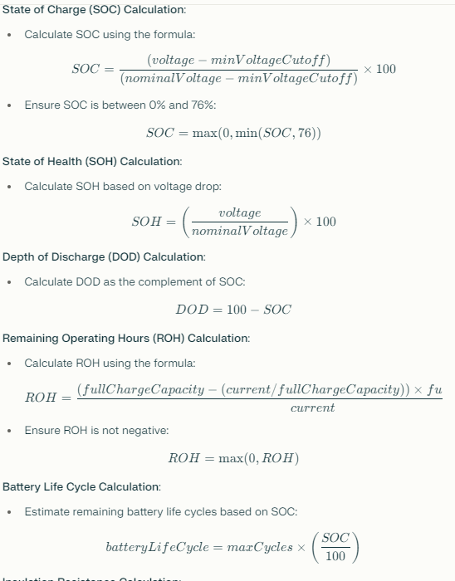
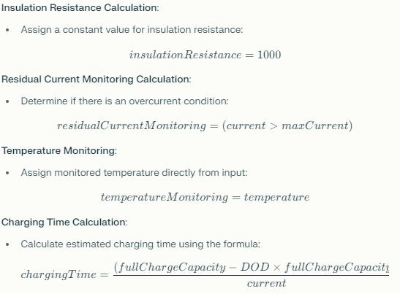
Algorithms
Car Charging control calculation
Input Parameters:
  Receive input values:
    voltage: Voltage of the battery in volts.
    current: Current flowing into the battery in amperes.
    temperature: Temperature of the battery in degrees Celsius.
Define Constants:
  Set constants for calculations:
    nominalVoltage = 12 (Nominal voltage of the battery in volts).
    maxCurrent = 100 (Maximum current rating in amperes).
    fullChargeCapacity = 100 (Full charge capacity in Ah).
    minVoltageCutoff = 10.5 (Minimum voltage cutoff for the battery in volts).
    maxCycles = 500 (Estimated maximum cycles for the battery life).
Voltage Level Calculation:
  Assign voltageLevel = voltage.
Current Level Calculation:
  Assign currentLevel = current.
  Calculation
Output Parameters:
  Return all calculated parameters:
    voltageLevel currentLevel
    SOC SOH DOD ROH
    batteryLifeCycle insulationResistance
    residualCurrentMonitoring temperatureMonitoring
    chargingTime

Slide 16
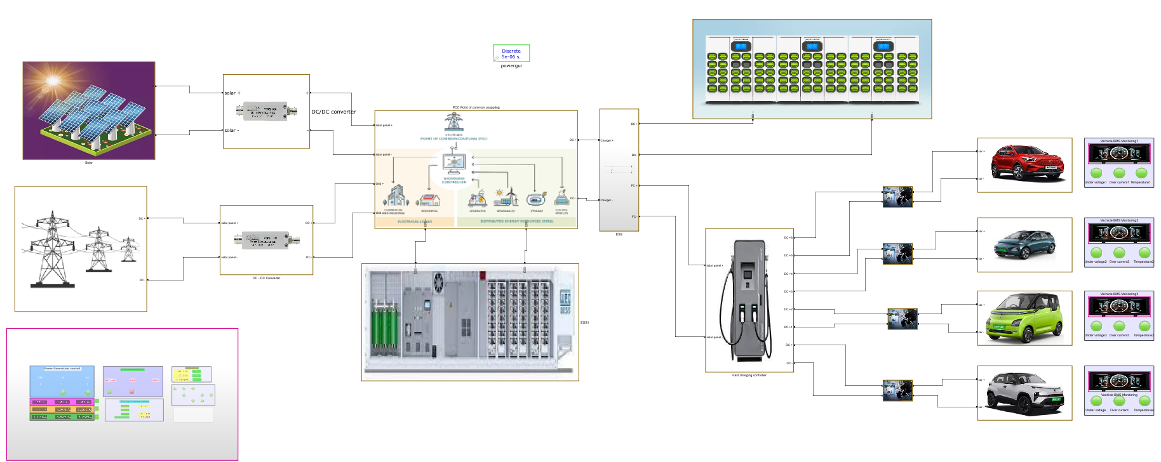
Swapping Station
Solar
Converter
PCC
Divider
Charging
Monitoring
Vehicles
Converter
Grid
ESS
Fast Charging
Central Monitoring System

Slide 17
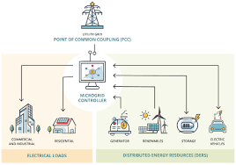
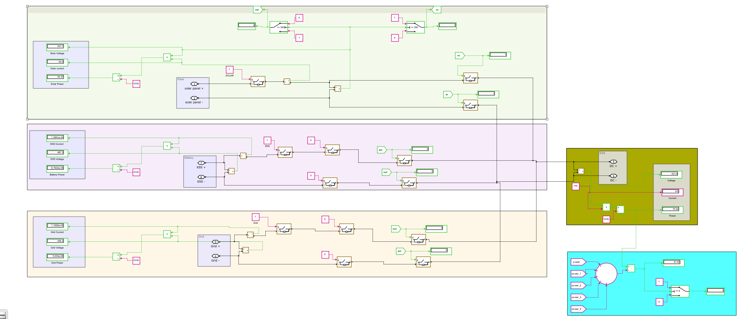
Integrated PCC – Point of common coupling – Fully Automated & Logically connected
Solar
ESS
PCC
Output
Grid
Power Management
Conditions
Solar – ON → ESS Charge → Grid OFF → Load ON -→ [ON – S1,S2,S5] – [OFF – S3,S4]
Solar – ON → ESS >80% → [Grid DC- AC] ON → Load ON -→ [ON – S1,S2,S5,S4] – [OFF – S3]
Solar – OFF → ESS ON → Grid OFF → Load ON -→ [ON – S2,S3,S4,S5] – [OFF – S1]
Solar – OFF → ESS <20% → [Grid DC- AC] ON → Load ON -→ [ON – S3,S5] – [OFF – S1,S2,S4]
Solar → OFF → ESS Charge → Grid ON—Load OFF
Output of PCC
Voltage 430 V
Current 80 A
Power KW/h 75 KW
Power / Day 1800 KW

Slide 18
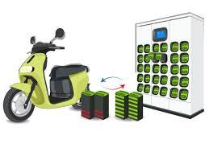
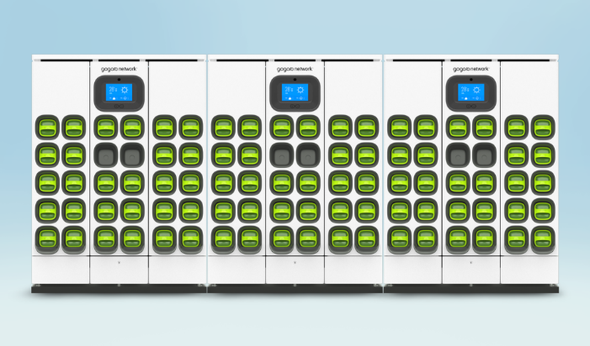
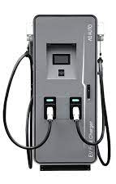
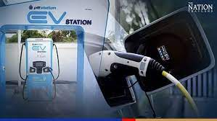

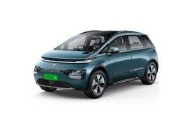


Swapping Station and DC Fast Charging
State of Charge (SoC): Available battery capacity as a percentage.
Battery Voltage: Voltage of individual battery packs.
Battery Current: Charging and discharging current measurements.
Battery Temperature: Monitors battery temperature for safety.
Swapping Time: Measures time taken for each battery swap.
Energy Usage: Measures of energy consumed during swaps.
Fault Detection: Identifies issues like short circuits.
Batteries – 30
Voltage - 12
Current - 10A
Power/ battery – 0.12kw
Cars | Voltage (V) | Power (kW) | Battery Capacity (kWh) | SOC Avaliable | Required Current | Charging Time in hr | Unit charge | Cost
1 - Tata Nexon - EV | 400 | 30.2 | 30.2 | 20 | 75.5 | 2.47 | 10 | 745.83
2- MG ZS EV | 400 | 50 | 44.5 | 30 | 125 | 1.49 | 10 | 743.75
3-Tata Trigo EV | 400 | 16.8 | 26 | 50 | 42 | 4.40 | 10 | 739.58
4- Mahindra eVerito | 400 | 70 | 60 | 10 | 175 | 1.07 | 10 | 747.92
Total Power |  | 167 |  |  | Total Time | 9 | Total Revenue | 2977

Slide 19
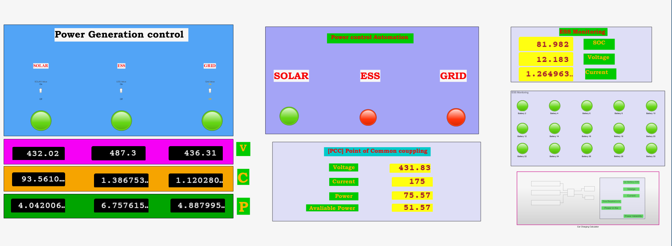
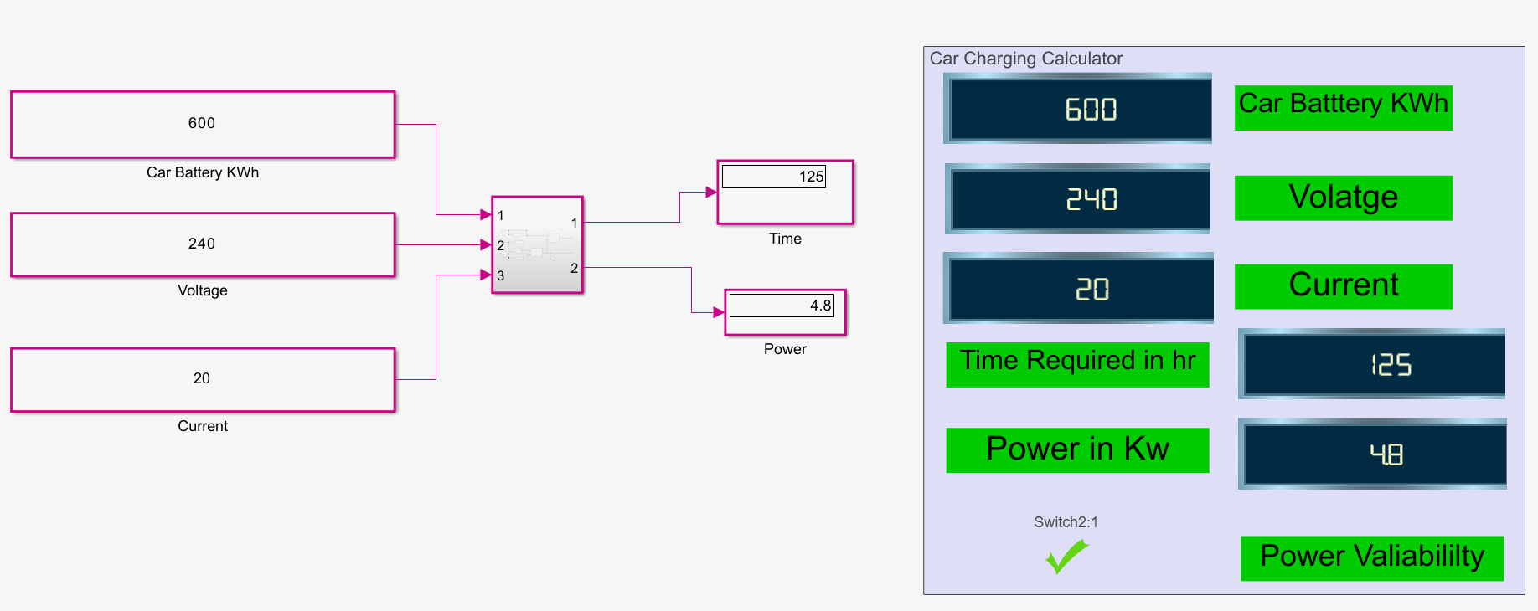
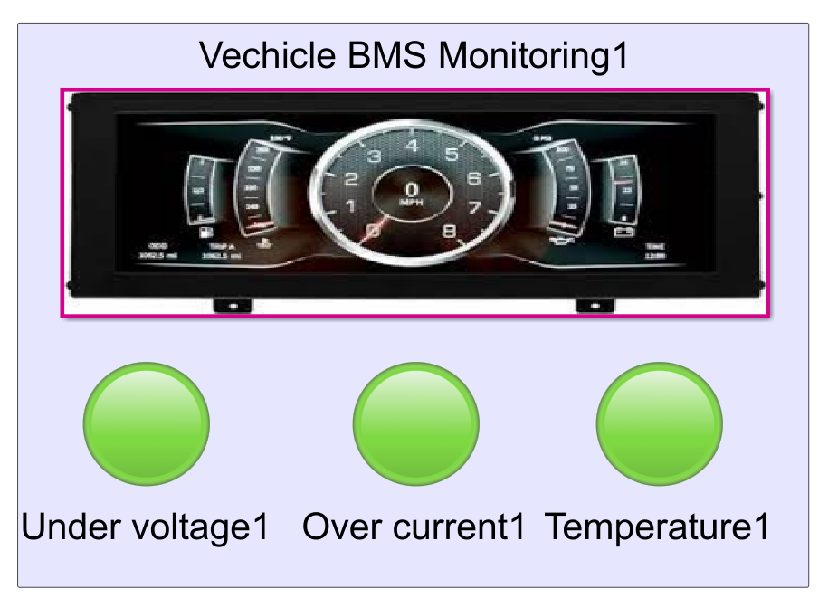
Central Monitoring Station
EV Parameters calculation
EV Battery charging Parameters

Slide 20
Power Generation |  |  |  |  |  |  | PCC - Point of common coupling |  |  |  |  | ESS - Charging
Power Source | Voltage [V] | Current [I] | % of Generation/day | Power [P]- KWh | Power/day |  | PCC will Logically be controlled on availability of source |  |  |  |  | No.of batteries | 40
Solar | 430 | 100 | 60 | 43 | 1032 |  | Voltage - [V] | 430 | Output Power/day in KW |  |  | Voltage | 12
ESS | 480 | 50 | 30 | 24 | 576 |  | Current - [I] | 80 |  |  |  | Amper hour - capacity | 100
Grid | 435 | 20 | 10 | 9 | 209 |  | Power - [W] - KW/h | 75 | 1800 | Gen /day |  | Power / charge - Watt / hr | 48000
Total Power Generation per day in KW/24 hr |  |  |  |  | 1817 |  | Power Avaliability | 1.17 | 1772 | use / day |  | Power / one cycle charge - KW | 48
Fast Charging Station Load
Cars | Voltage (V) | Power (kW) | Battery Capacity (kWh) | SOC Avaliable | Required Current |  | Charging Time in hr |  | Unit charge | Cost
1 - Tata Nexon - EV | 400 | 30.2 | 30.2 | 20 | 75.5 |  | 2.47 |  | 10 | 745.83
2- MG ZS EV | 400 | 50 | 44.5 | 30 | 125 |  | 1.49 |  | 10 | 743.75
3-Tata Trigo EV | 400 | 16.8 | 26 | 50 | 42 |  | 4.40 |  | 10 | 739.58
4- Mahindra eVerito | 400 | 70 | 60 | 10 | 175 |  | 1.07 |  | 10 | 747.92
Total Power |  | 167 |  |  | Total Time |  | 9 |  | Total Revenue | 2977
Total Power |  | 1670 | KW power can charge / day |  | Total Time |  | 94 | / 96 hr | Total Revenue | 26794
Battery Swapping Station
Total Batteries | 30
Under maintance | 0
Avaliable batteries | 30
Voltage | 12 |  | Total Batteries charging / day |  |  | 90
Current | 10 |  | Cost of charge per battery |  |  | 30
Time / Battery in hr | 5 |  | Total Amout Per day |  |  | 2700
No of Cycle per day | 3
Power/Battery - KW | 0.12
Total Station KW | 18
Total Energy Required for Full Swapping Station per Day - KW | 54

Slide 21
Total Energy calculation
Power sources | KW / day | KW / Month | KW / year | KW / 5 years
Required full Power From Grid | 1,817 | 54,504 | 663,132 | 3,315,660
Solar | 1,032 | 30,960 | 376,680 | 1,883,400
ESS | 576 | 17,280 | 210,240 | 1,051,200
Grid | 209 | 6,264 | 76,212 | 381,060
Total Power saving / Day | 1,608 | 48,240 | 586,920 | 2,934,600
Total Cost / Day 12rs / unit | 21,802 | 654,048 | 7,957,584 | 39,787,920
Total Cost Saving / Day 12rs / unit | 19,296 | 578,880 | 7,043,040 | 35,215,200
Spending Amount | 2,506 | 75,168 | 914,544 | 4,572,720
Revenue
Source | Per day | Per Month | Per Year | Per 5 Years
Fast charging | 26,794 | 803,813 | 9,779,719 | 48,898,594
Battery Swapping | 2,700 | 81,000 | 985,500 | 4,927,500
Total Revenue | 29,494 | 884,813 | 10,765,219 | 53,826,094
Spending Amount | 2,506 | 75,168 | 914,544 | 4,572,720
Total Profit | 26,988 | 809,645 | 9,850,675 | 49,253,374

Slide 22
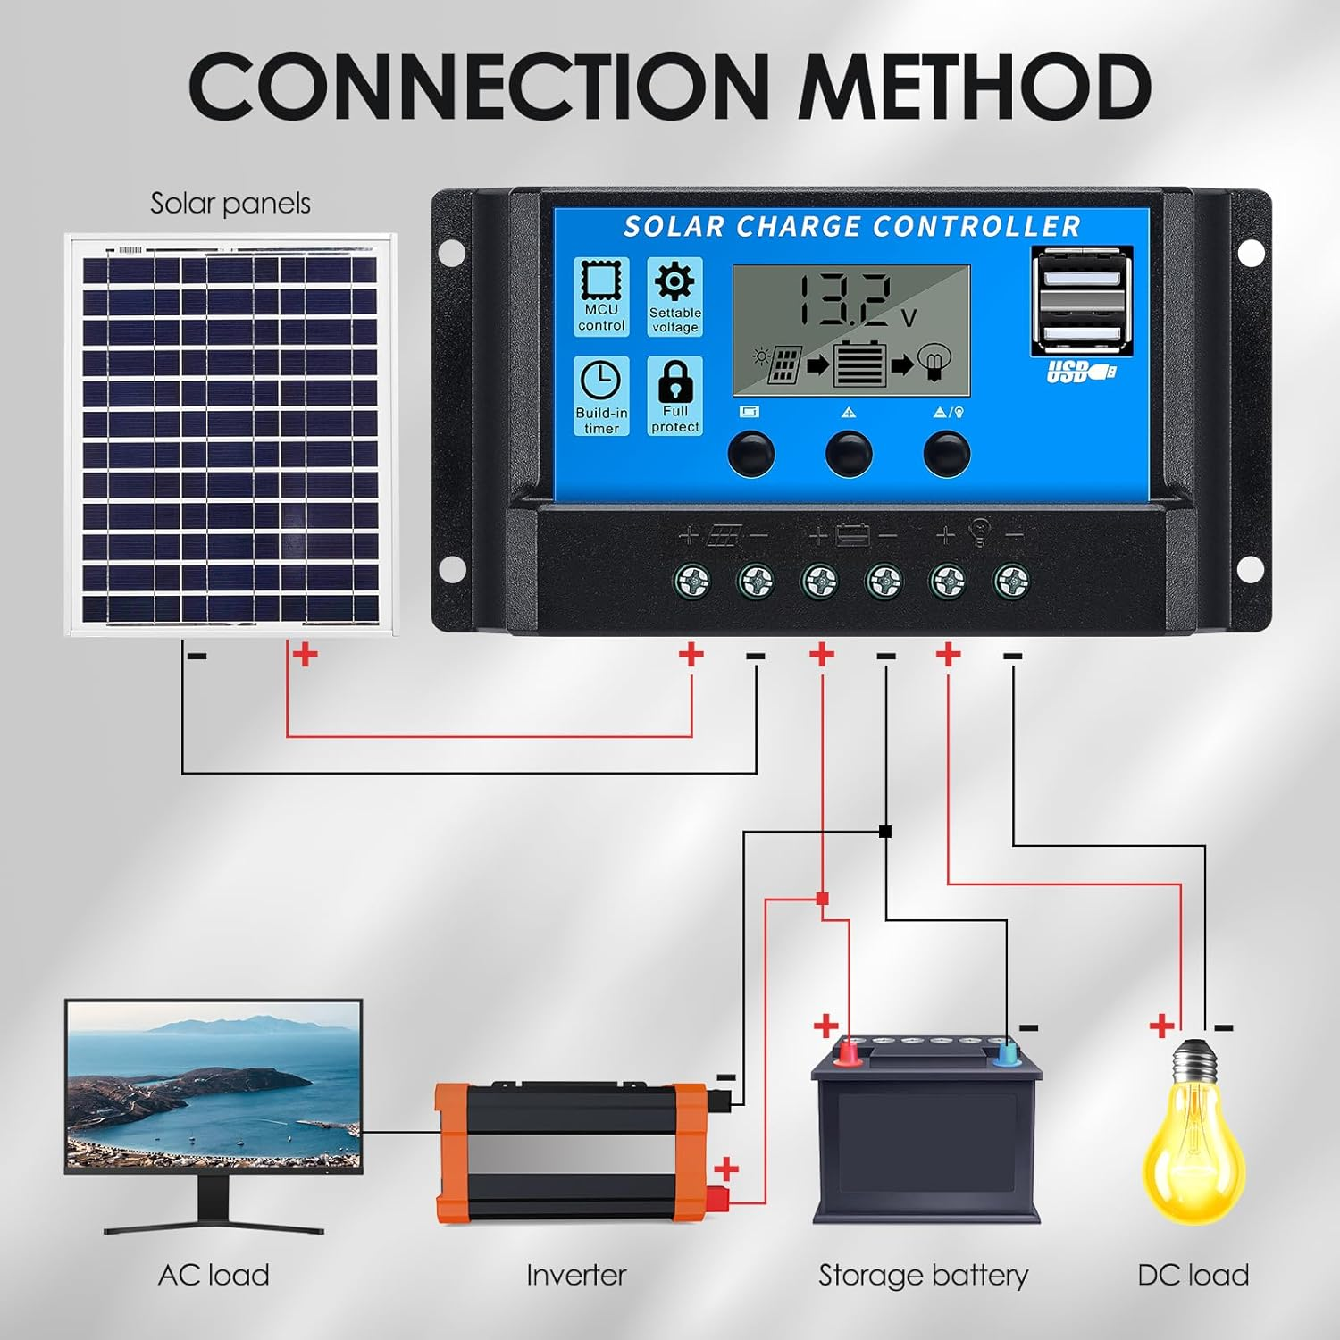
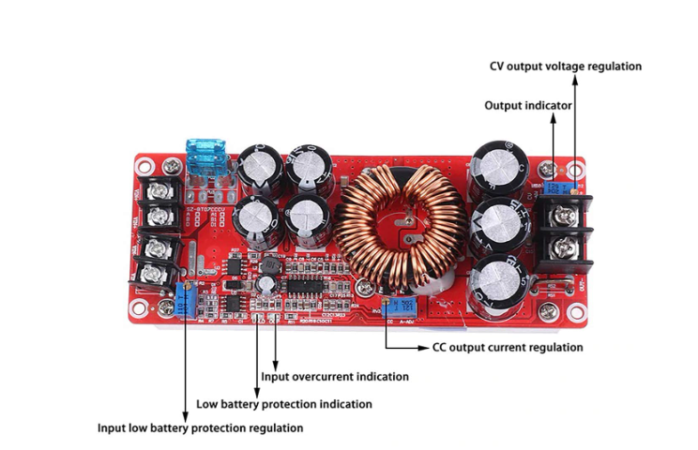
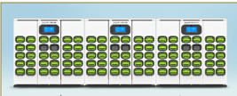
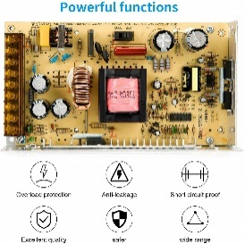
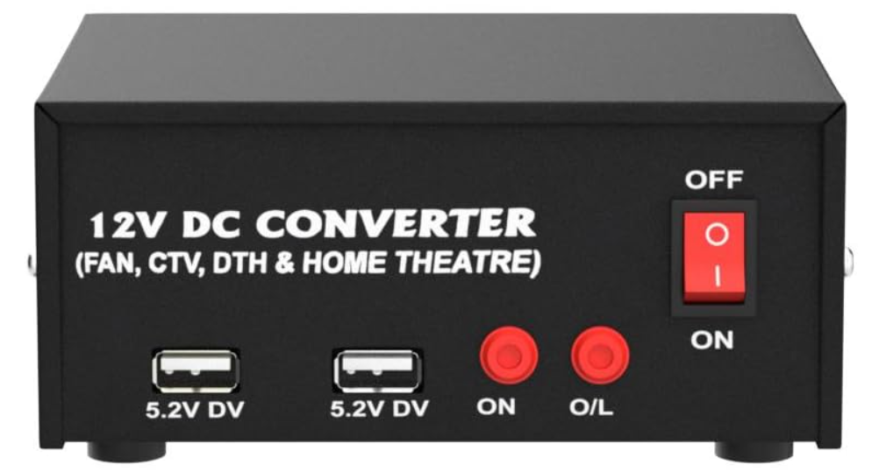
Automation Energy Sensor monitoring
Procurement_ Part – 2
Solar
Voltage, Current, Temp, RTC, Humidity, Light Intensity, SW – M/C_1
ESS
Voltage, Current, Temp, SW – M/C_2
Grid
AC – DC - Adopter → Voltage, Current , SW – M/C_3
DC – AC Converter
Voltage, Current(AC - Sensors) SW – M/C_4
Load
DC – DC Converter
1. Swapping - Voltage, Current, SW – M/C_4
2. Fast charge – 12 Batteries Voltage, Current, SW – M/C_5
Solar
DC – DC
Converter
M-1
SW_1
SW_5
M-5
SW_2
M-5
Grid
M-3
DC
M-2
AC
SW_3
DC
AC
M-4
SW_4

Slide 23
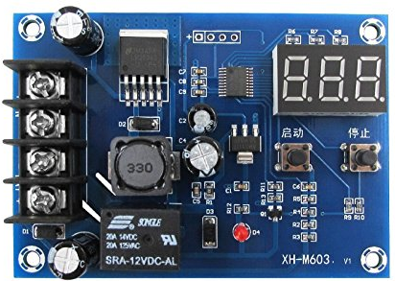
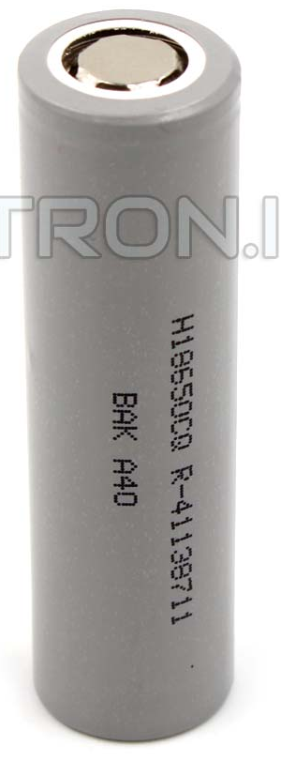

Load source
DC Power
Procurement_ Part – 3
Swapping
batteries - 10,
Centlot xt M60312V Digital charger controller
Voltage
Current
Temperature
M-5
M-6

Slide 24
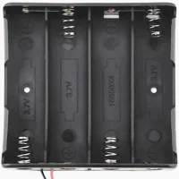
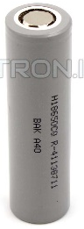
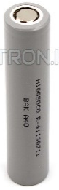
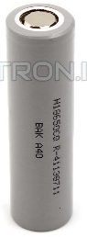
Load source
DC Power
Procurement_ Part – 4
Swapping
batteries - 3*4 = 12,
Centlot xt M60312V Digital charger controller
Voltage
Current
Temperature
M-5
M-7

Slide 25
Tools Used
MATLAB Simulation
Spreadsheet
Node Red
AWS
Conclusion
Energy Source Integration
Optimized Charging Solutions
Energy Cost Saving
Future Stability with IOT Connectivity
Future Works
1. Hardware setup

Slide 26

Thankyou
"Engineering is the closest thing to magic that exists in the world."
– Elon Musk

Slide 27
Drivers
Challenges
Technology
Charger Rollout
Regulation
Supply Chain Issues
EV Charging Growth
Consumer Desire
Vehicle Charger availability
Decarbonisation
Roaming Chargers
Economics
Grid Capacity

